Slide 1
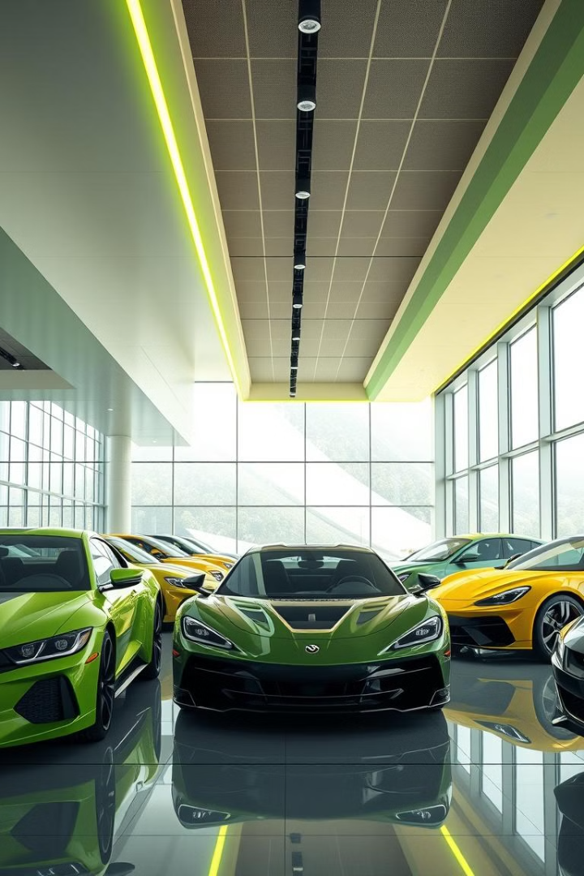
Rahik Car Shop E-commerce Website
My Car Shop is a comprehensive e-commerce website designed to revolutionize the car buying experience for customers. The website offers a seamless and intuitive platform for users to browse, purchase, and manage their dream cars.
Md Rahik
Daffodil Institute of IT
Computer science & technology

Slide 2
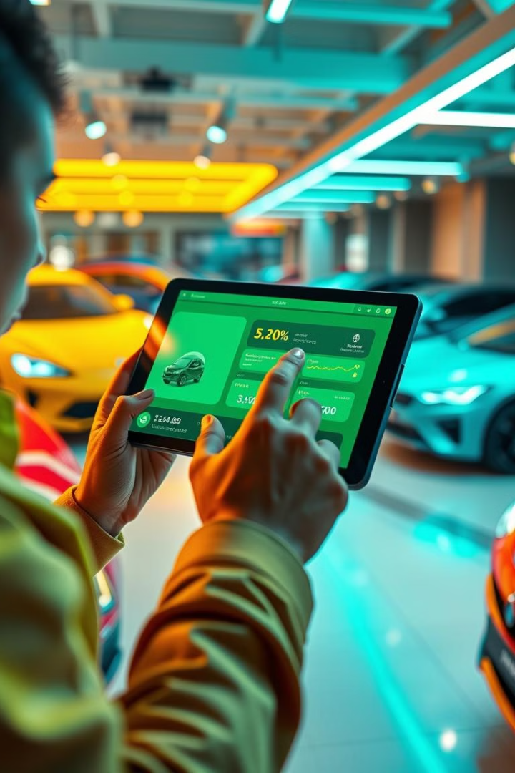
Objective & User Focus
Primary Goal
My Car Shop's primary objective is to provide an exceptional car shopping experience for users. This includes offering a wide range of car options, ensuring efficient and reliable customer service, and simplifying the online car buying process.
User Focus
The website focuses on user-centric design, prioritizing simplicity and ease of use. It utilizes intuitive systems and features to streamline the car buying process and ensure a smooth and secure online experience for users.

Slide 3

Frontend Technology
1
ReactJS
ReactJS is used to construct interactive and dynamic user interfaces (UIs) for the website. React's component-based architecture provides a flexible and efficient framework for building responsive and engaging user experiences.
2
HTML & CSS
HTML and CSS provide the fundamental structure and styling for the website. HTML defines the content and layout of the webpages, while CSS is used to create the visual appearance and aesthetics.
3
Tailwind CSS
Tailwind CSS is employed to create responsive and modern user interfaces efficiently. Its utility-first approach allows for rapid development and ensures a consistent visual style across the platform.
4
Redux Toolkit
Redux Toolkit is utilized for state management within the React application. This powerful library provides a robust and organized framework for managing complex application data and interactions.

Slide 4
Backend Technology
NodeJS & ExpressJS
MongoDB
JWT-based Authentication
NodeJS and ExpressJS are the foundation of the backend, powering the server-side logic and API endpoints. NodeJS provides a fast and scalable runtime environment, while ExpressJS offers a robust framework for building RESTful APIs.
MongoDB is a NoSQL database used for storing data. Its flexible and scalable nature makes it ideal for managing large datasets efficiently. MongoDB's document-oriented structure allows for easy integration with the website's dynamic content.
A secure user verification system is implemented using JSON Web Tokens (JWT). JWTs are used to securely verify user credentials during signup and login, ensuring the integrity and security of the platform.

Slide 5
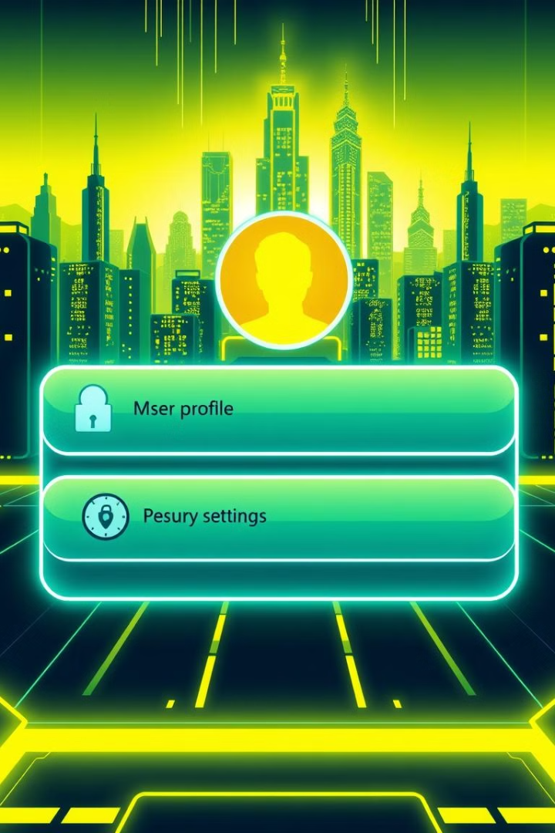


User Authentication & Authorization
User CRUD
My Car Shop enables users to perform various operations on their accounts, including registration, login, profile updates, and account management.
JWT Verification
During signup and login processes, the website utilizes JWT verification to ensure the authenticity and security of user credentials.

Slide 6
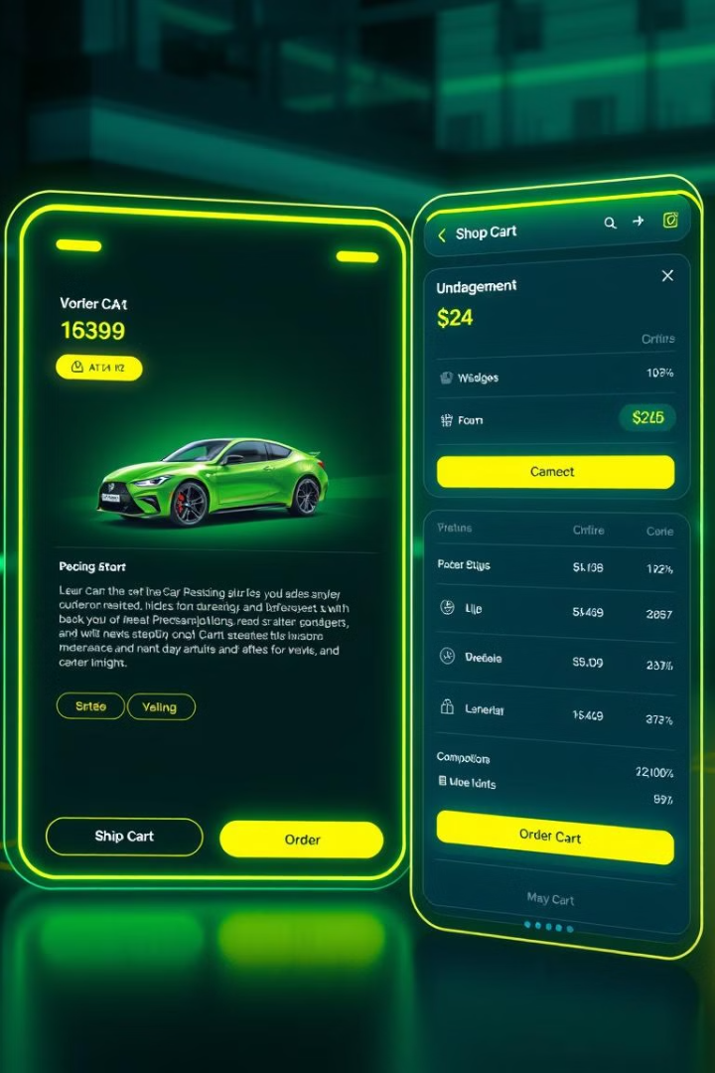
Car & Order Management
1
Car CRUD Operations
Administrators have access to comprehensive car management features, allowing them to add, update, delete, and manage car listings efficiently.
2
Order CRUD Operations
Users can seamlessly place, track, and manage their car purchases through the website's intuitive order system. The website allows users to view order history, track shipment progress, and update order details.

Slide 7

Reviews & Ratings
Review Submission
Users can submit their own reviews and ratings for cars they have purchased, providing valuable feedback for other potential buyers.
Review Moderation
Administrators moderate all submitted reviews to ensure quality, relevance, and adherence to website guidelines.
Review Display
Verified reviews and ratings are displayed on the car listing pages, helping users make informed decisions based on real-world experiences.

Slide 8
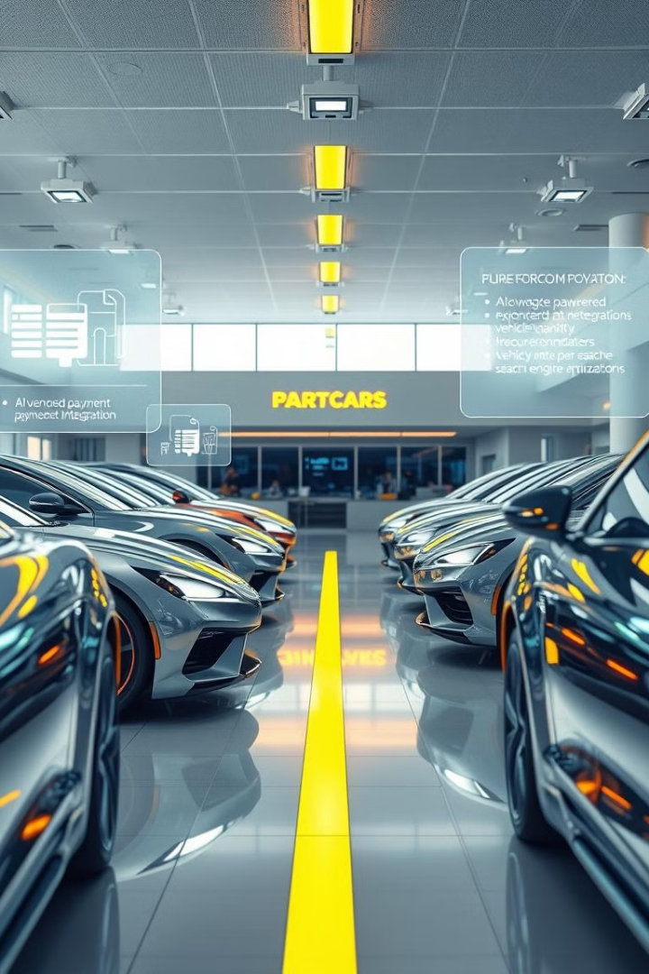



Future Enhancements
Payment Integration
Integration with secure payment gateways will enable seamless online transactions for car purchases. Users will be able to complete their purchases securely and conveniently using various payment methods.
Recommendation System
The website will implement a personalized recommendation system to suggest cars that match users' preferences and past search history. This feature will enhance the user experience by providing relevant and targeted car suggestions.
SEO Optimization
My Car Shop will focus on improving its search engine visibility through continuous SEO optimization. This will increase the platform's discoverability and attract a wider audience.

